Slide 1
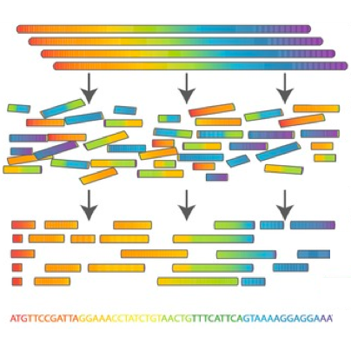

Scientific Computing for Biologists

Slide 2
Scientific Computing for Biologists
5-10 minutes for class discussion and dialog over previous lesson(s)…
Questions about previous lecture(s)?
Discussion of Final Project progress?
General Questions about scientific computing?

Slide 3
Scientific Computing for Biologists
Why learn the command line?
It’s the foundation for most of bioinformatics
Enables use of non-GUI (Graphical User Interface) tools
Can quickly perform operations on large files
Reproducibility
Automation of repetitive tasks
Enables use of higher-powered computers elsewhere (server/cloud)

Slide 4
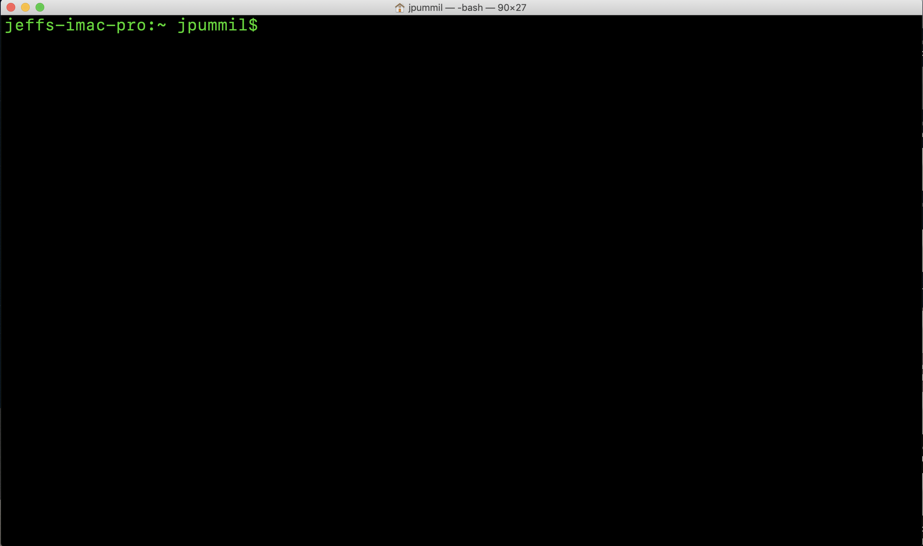
Scientific Computing for Biologists

Slide 5
Scientific Computing for Biologists
Terminal icon SHOULD be on the task bar already! If not…
To locate your terminal app, just go to the Finder on your iMac:
Select Applications
Then Utilities
Drag and drop the icon from Utilities onto the task bar

Slide 6
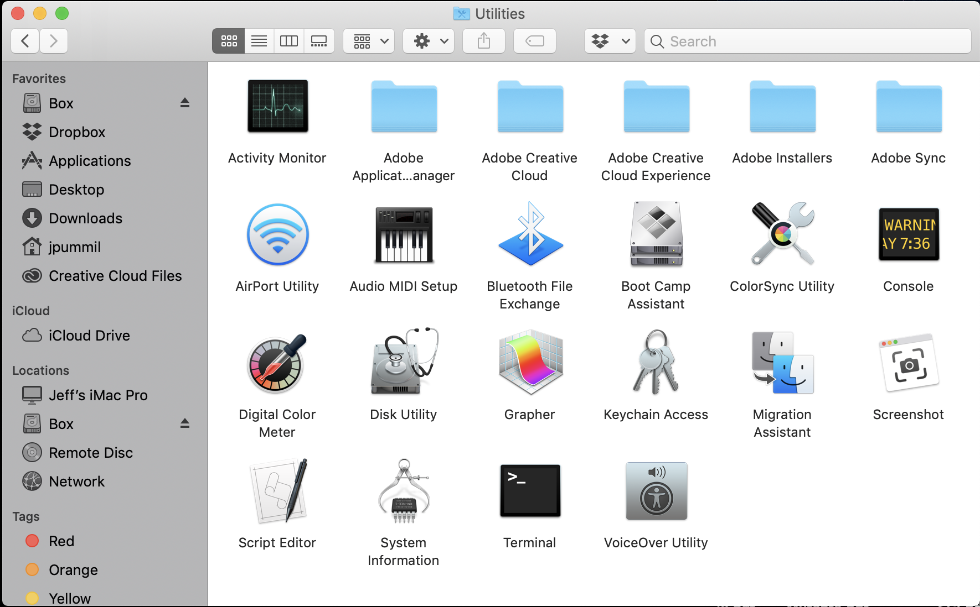
Scientific Computing for Biologists

Slide 7
Scientific Computing for Biologists
A few basic tips before we begin:
Linux/Unix is case sensitive – TEST, Test, and test are all DIFFERENT
Avoid spaces in filenames – test one (bad). test-one or test_one (good)
DO NOT use Windows to create text files you will use on Linux.
Windows adds hidden characters that won’t work on Linux.
DO assign suffixes to file names. Ex: test should be test.txt or test.dat
Linux doesn’t care…but humans need it to keep track.

Slide 8
Scientific Computing for Biologists
So, now you have your terminal all fired up, let’s get started! Some basic commands to begin with:
whoami - display effective user id
pwd – prints (displays) current working directory (folder)
ls – list contents of directory
command flags ( -l, -h, -a, and -F )
Use command –help to show all available flags
cd – change working (current) directory
short cuts ( ~, /, and . )
BONUS COMMAND: clear – clears the messy text in the terminal

Slide 9
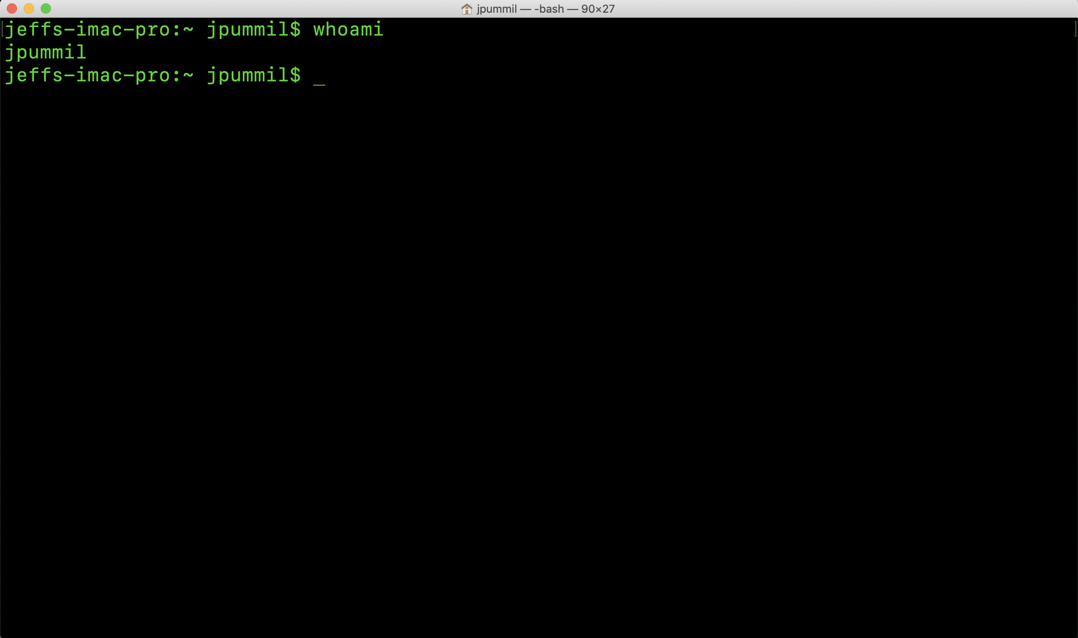
Scientific Computing for Biologists

Slide 10
Scientific Computing for Biologists
So, now you have your terminal all fired up, let’s get started! Some basic commands to begin with:
whoami - display effective user id
pwd – prints (displays) current working directory (folder)
ls – list contents of directory
command flags ( -l, -h, -a, and -F )
Use command –help to show all available flags
cd – change working (current) directory
short cuts ( ~, /, and . )
BONUS COMMAND: clear – clears the messy text in the terminal

Slide 11
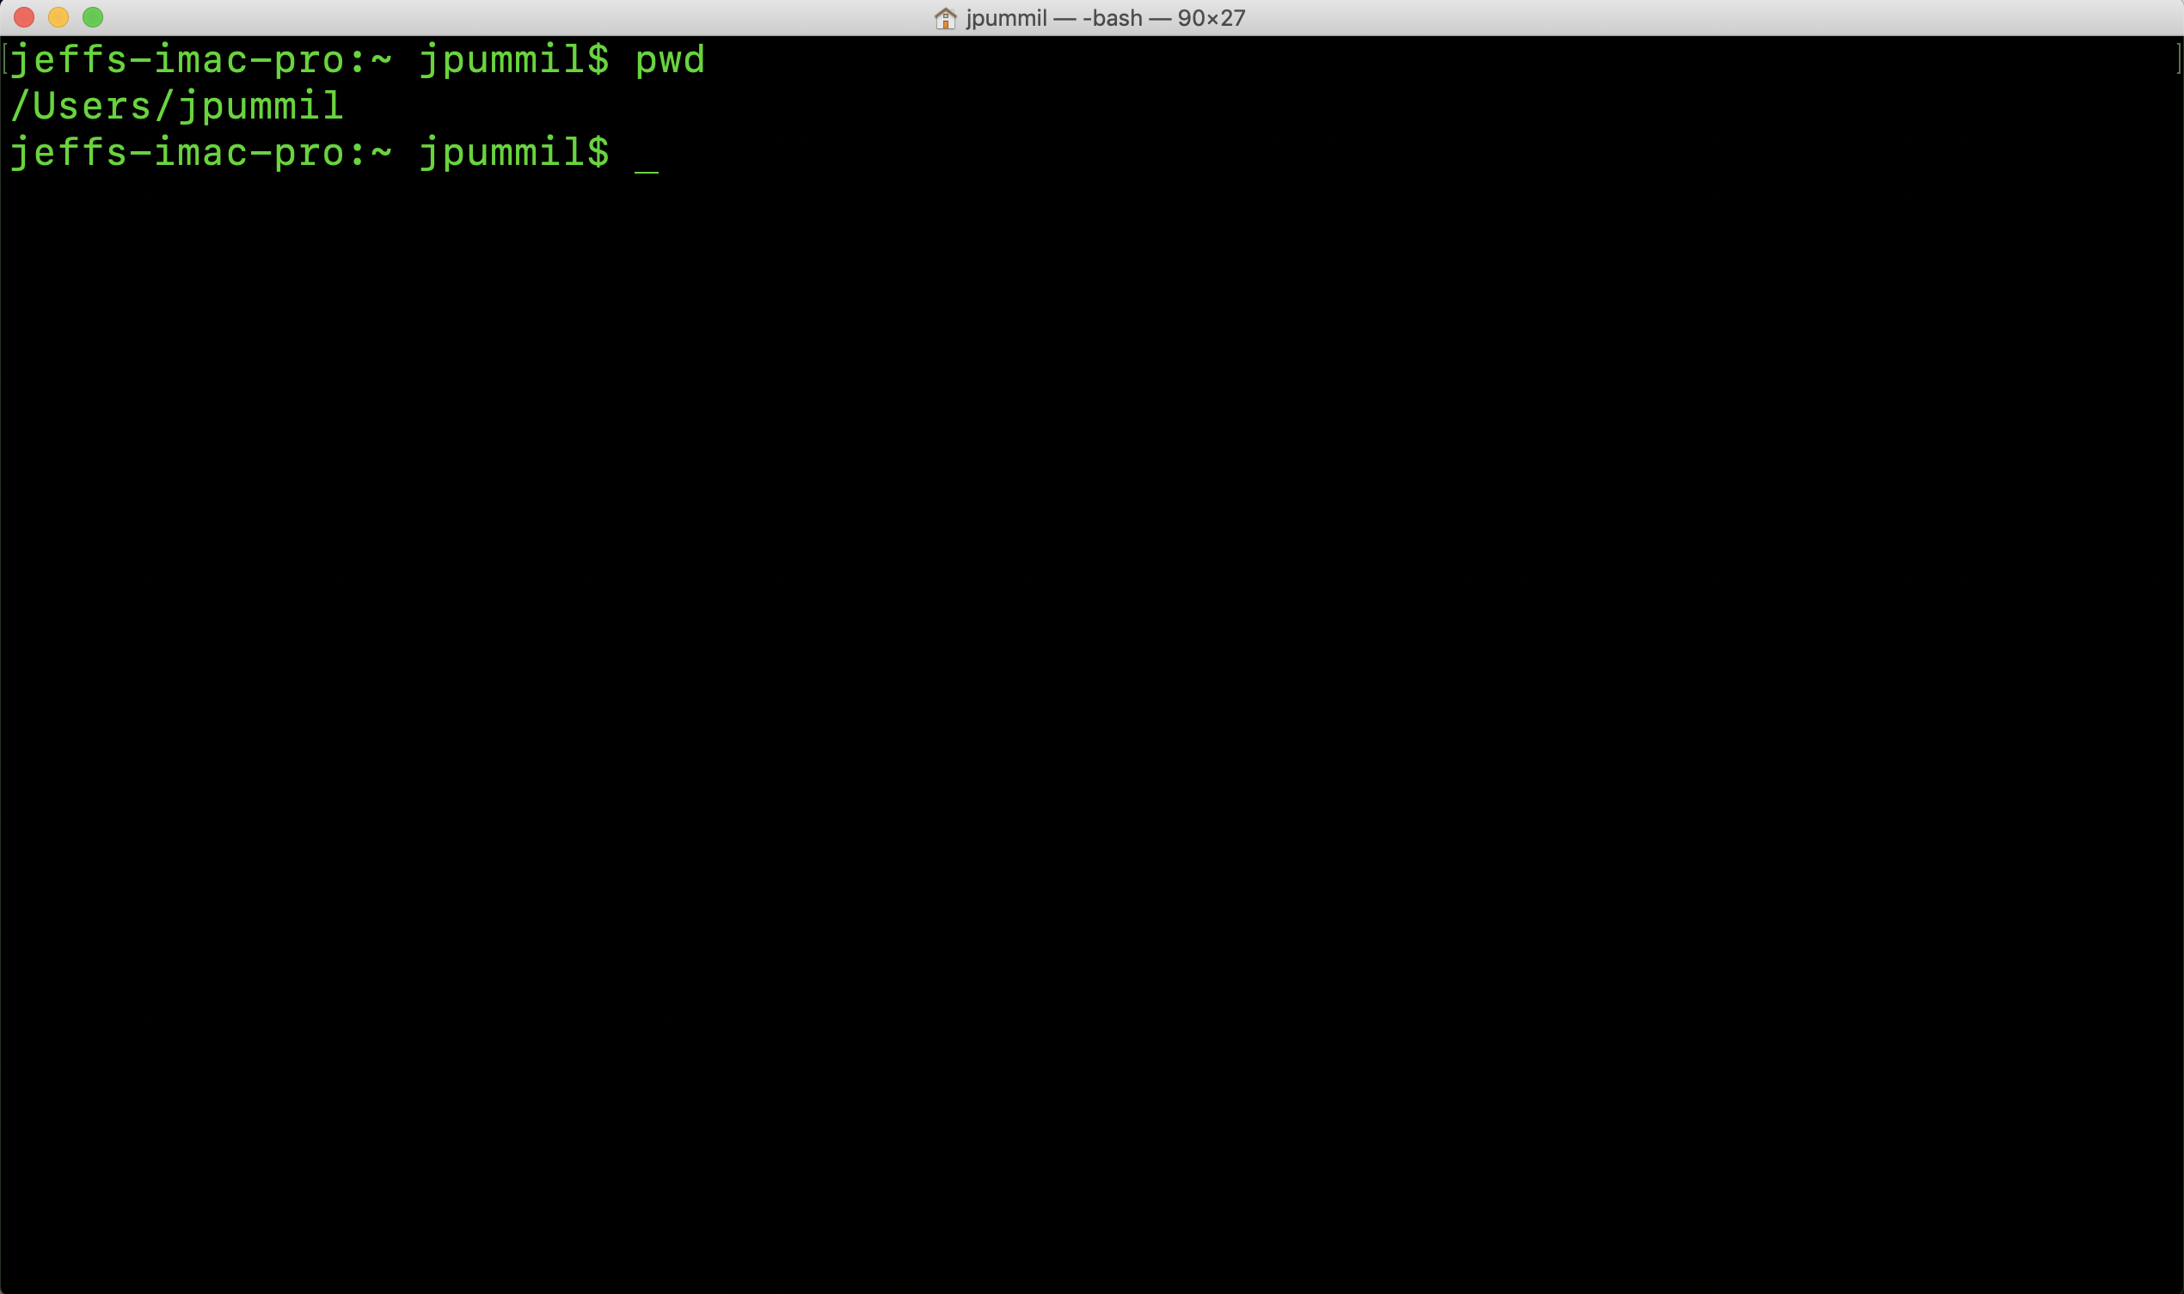
Scientific Computing for Biologists

Slide 12
Scientific Computing for Biologists
So, now you have your terminal all fired up, let’s get started! Some basic commands to begin with:
whoami - display effective user id
pwd – prints (displays) current working directory (folder)
ls – list contents of directory
command flags ( -l, -h, -a, and -F )
Use command –help to show all available flags
cd – change working (current) directory
short cuts ( ~, /, and . )
BONUS COMMAND: clear – clears the messy text in the terminal

Slide 13
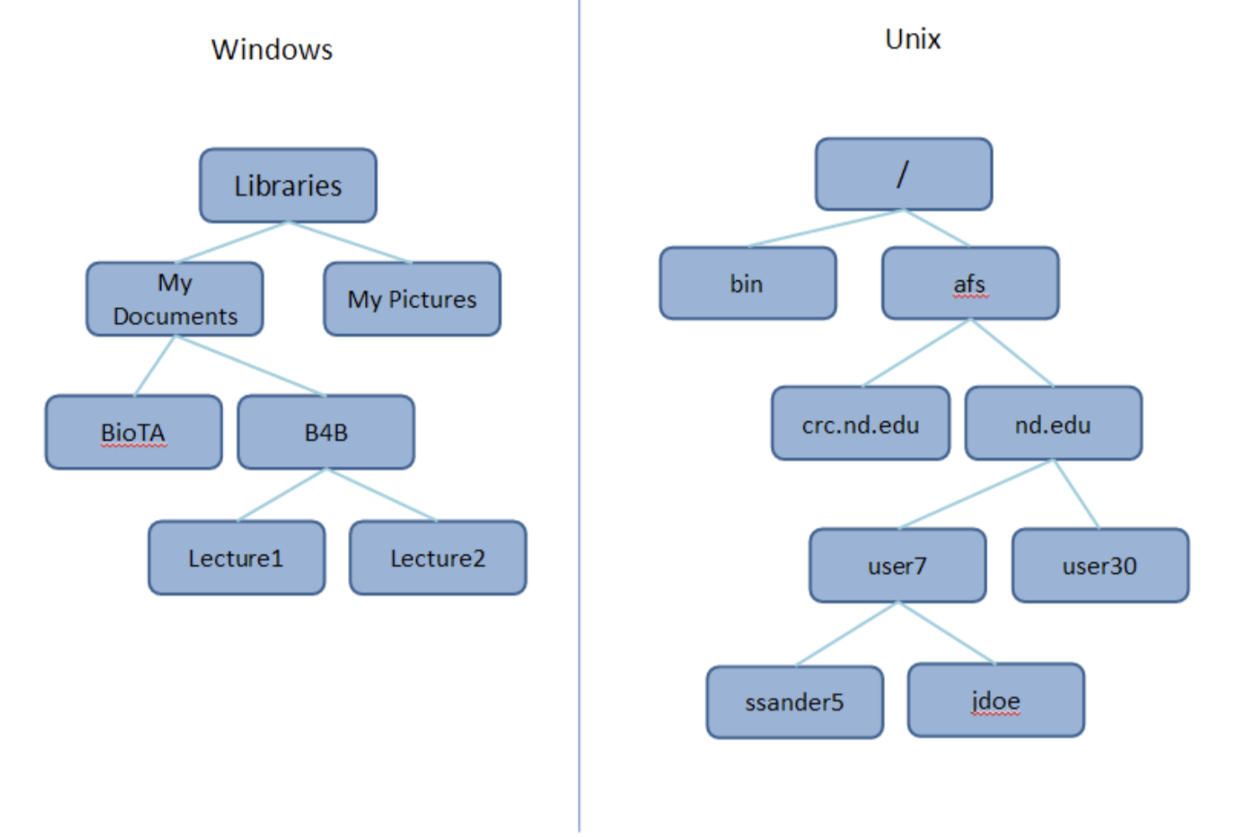
Scientific Computing for Biologists

Slide 14
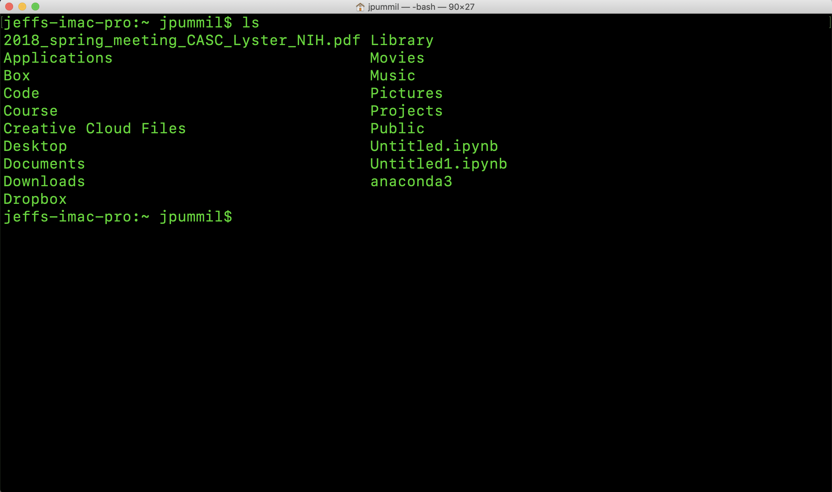
Scientific Computing for Biologists

Slide 15
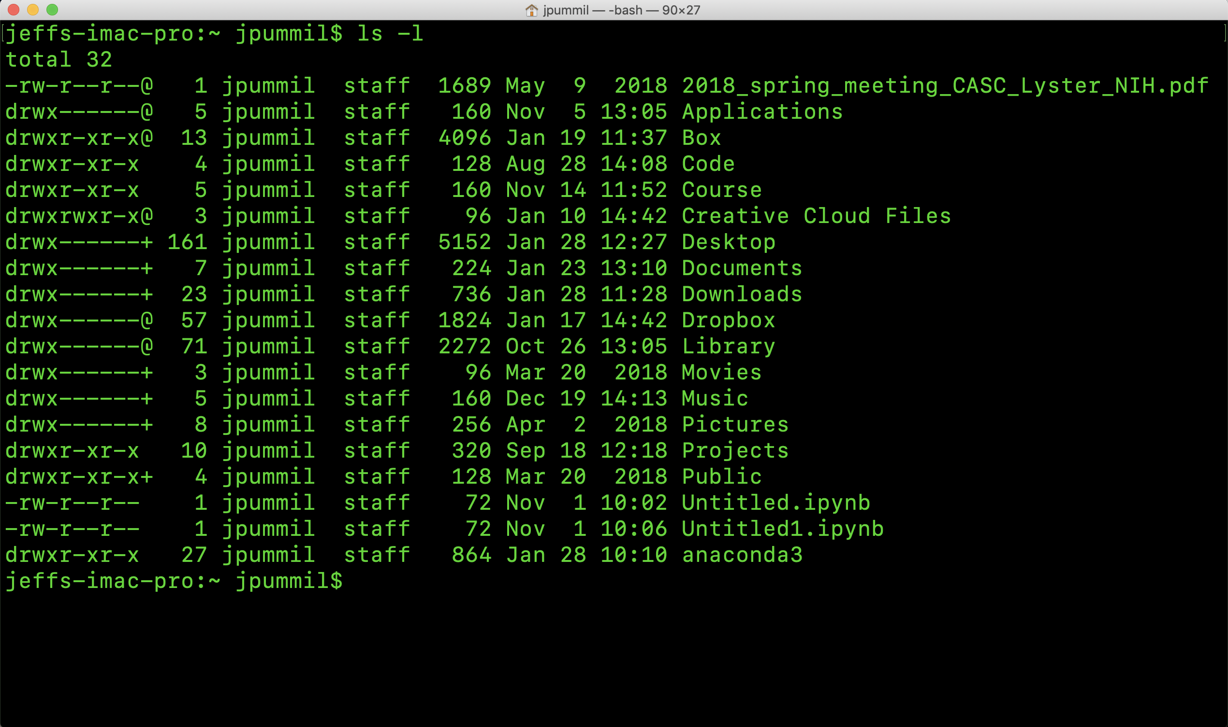
Scientific Computing for Biologists

Slide 16
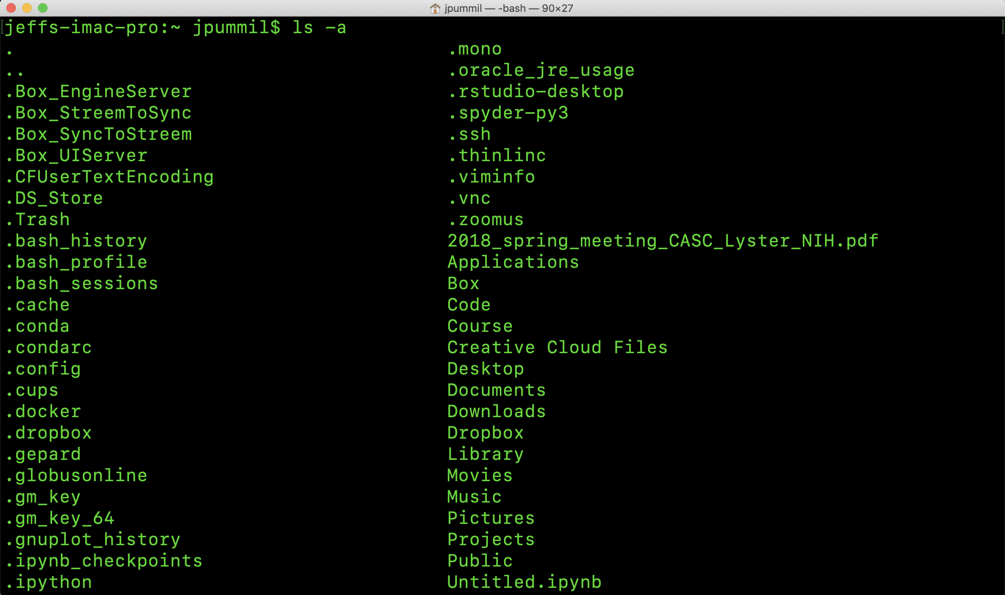
Scientific Computing for Biologists

Slide 17
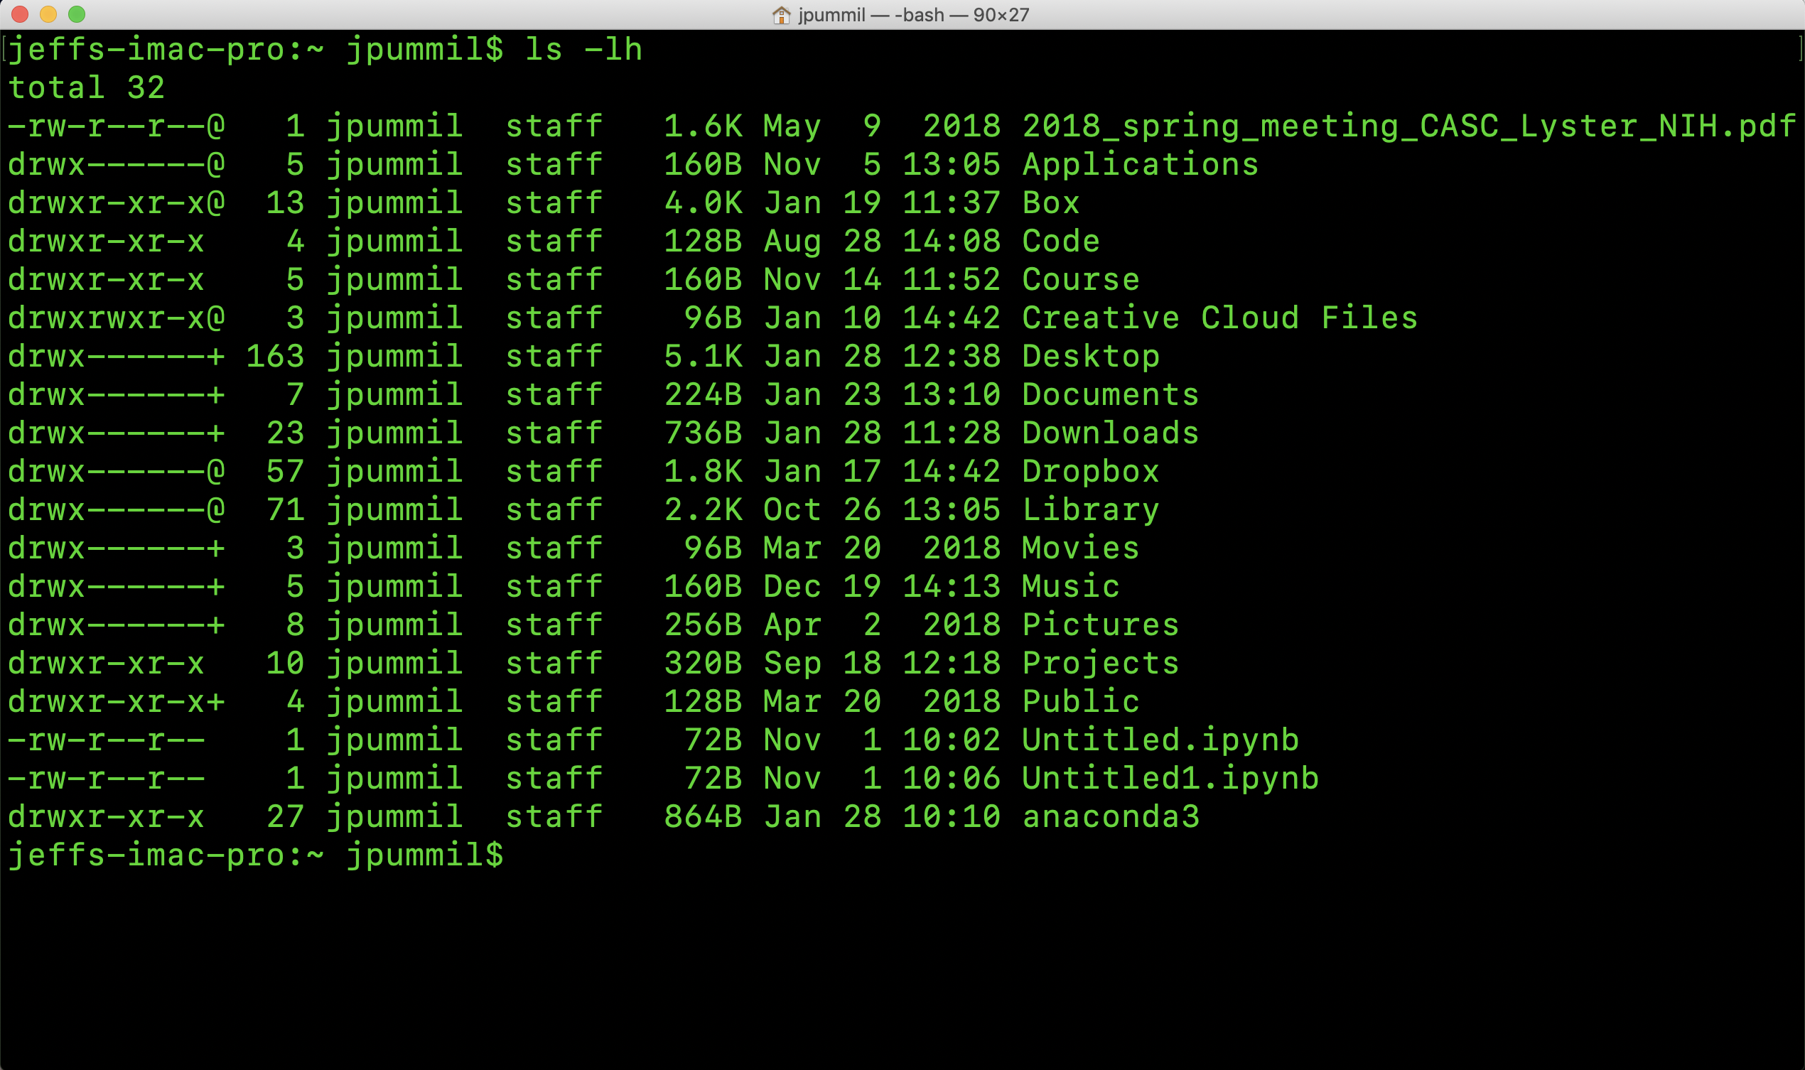
Scientific Computing for Biologists

Slide 18
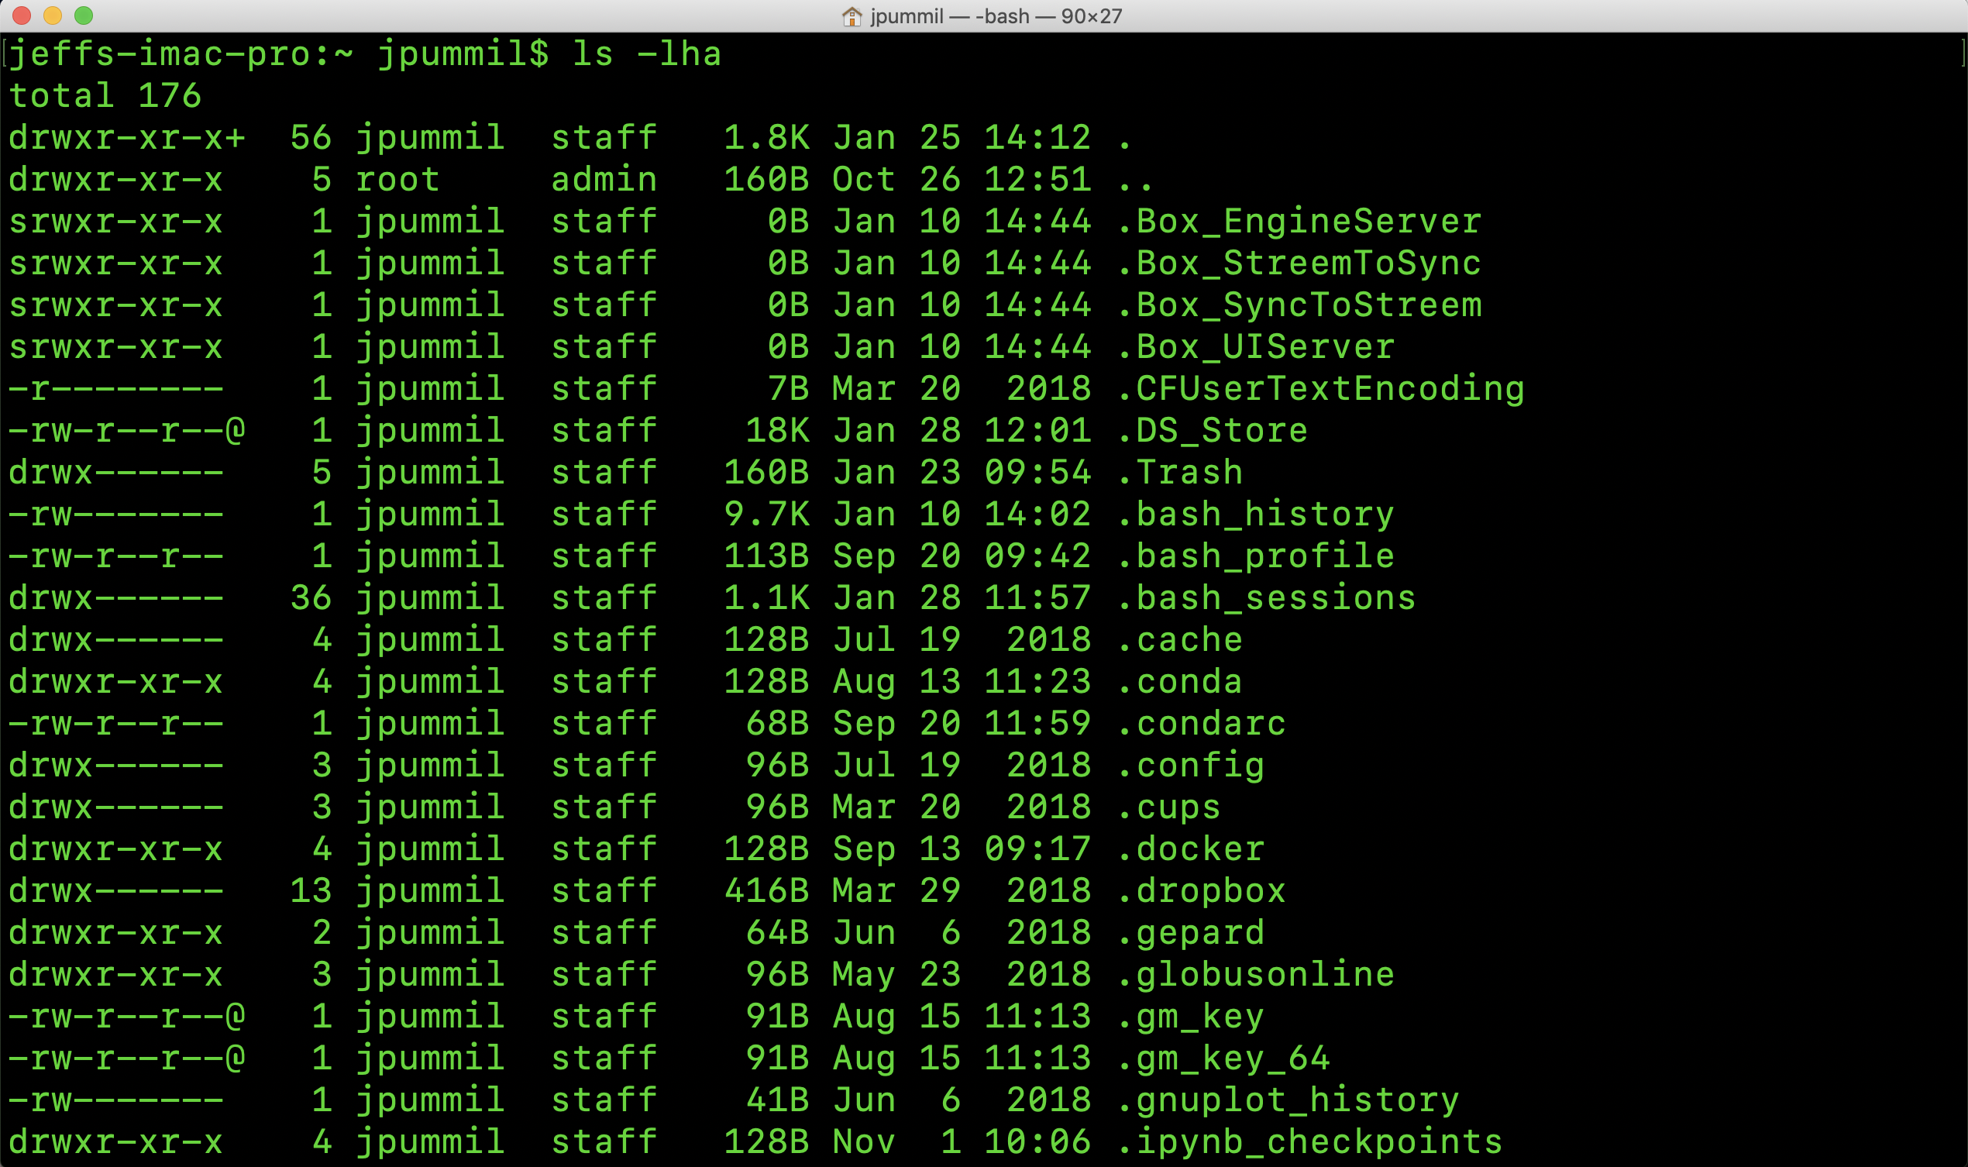
Scientific Computing for Biologists

Slide 19
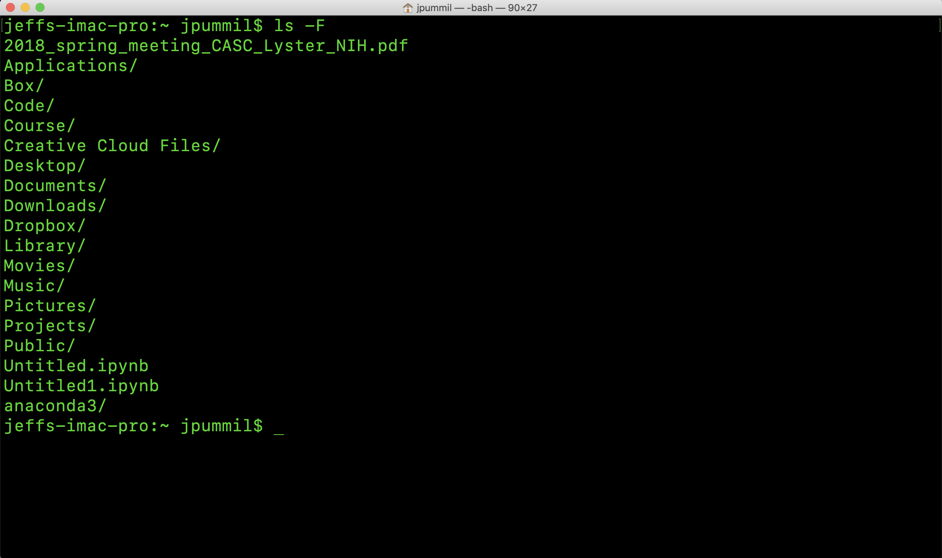
Scientific Computing for Biologists

Slide 20
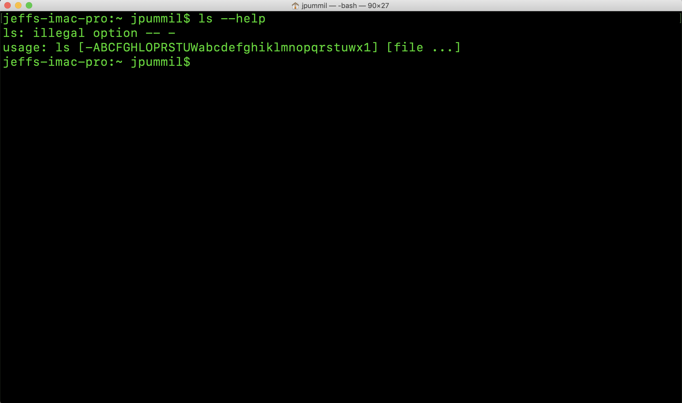
Scientific Computing for Biologists

Slide 21
Scientific Computing for Biologists
Half time!
5-10 minute break…

Slide 22
Scientific Computing for Biologists
So, now you have your terminal all fired up, let’s get started! Some basic commands to begin with:
whoami - display effective user id
pwd – prints (displays) current working directory (folder)
ls – list contents of directory
command flags ( -l, -h, -a, and -F )
Use command –help to show all available flags
cd – change working (current) directory
short cuts ( ~, /, and . )
BONUS COMMAND: clear – clears the messy text in the terminal

Slide 23
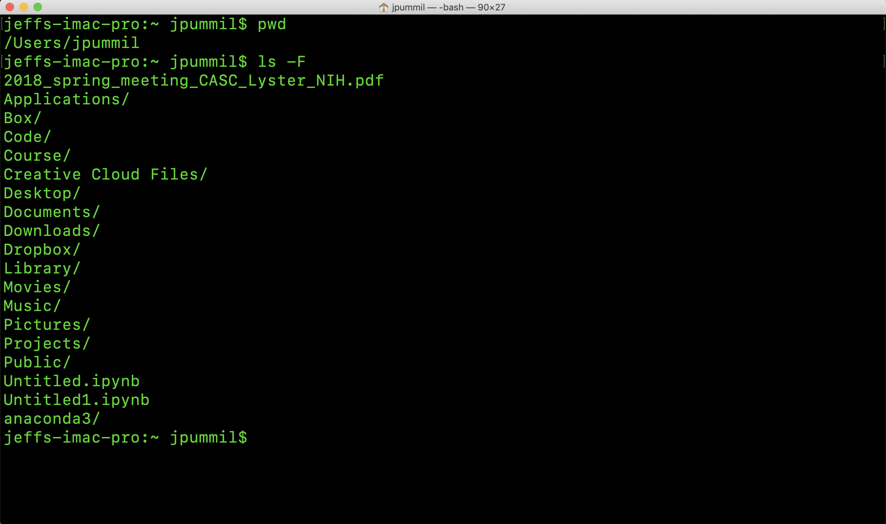
Scientific Computing for Biologists

Slide 24
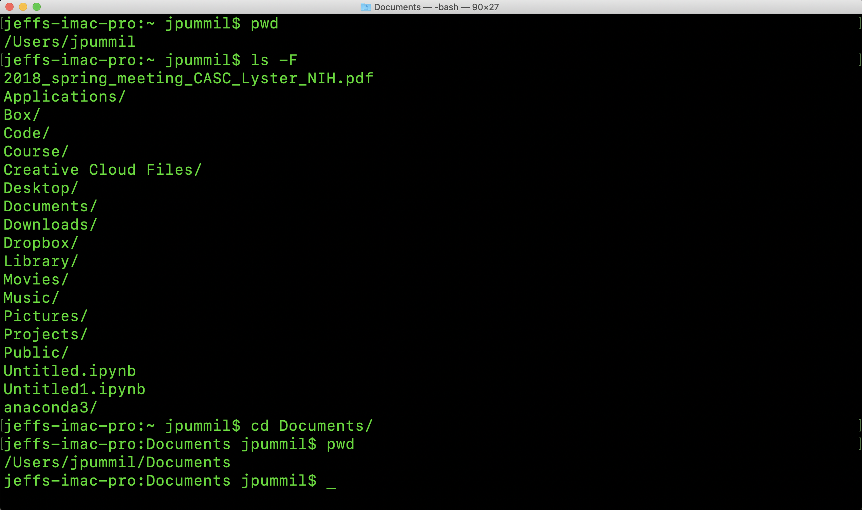
Scientific Computing for Biologists

Slide 25
Scientific Computing for Biologists
So, now you have your terminal all fired up, let’s get started! Some basic commands to begin with:
GREAT! So, cd changed my working directory…but what if I want to get back to MY directory?
cd /Users/<username>
cd .. (two dots means “up one directory)
cd ~ ( tilde character is shortcut representing “home”)
/ is a directory separator
Thus, if you wanted to go up TWO directories…you could use “../..”

Slide 26
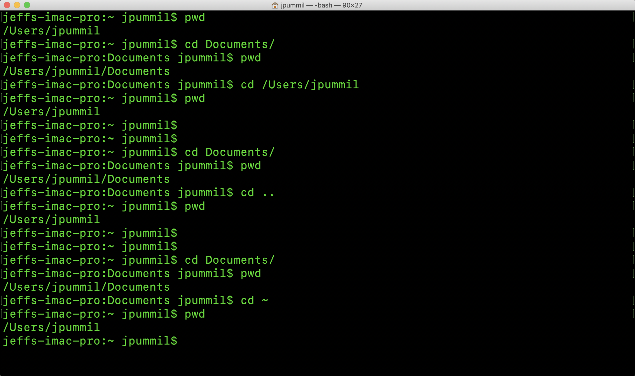
Scientific Computing for Biologists

Slide 27
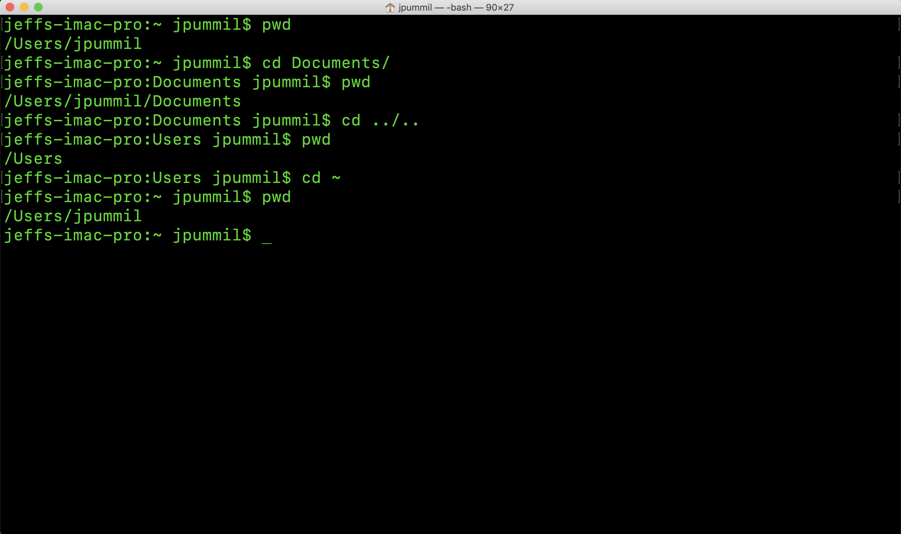
Scientific Computing for Biologists

Slide 28
Scientific Computing for Biologists
For the rest of this class session, experiment with:
Using ls with as many of the optional flags as you when you used
ls –help earlier
Moving around in the file system with cd, ~, .., /, etc

Slide 29
Scientific Computing for Biologists
Jeff Pummill
Director – Strategic Initiatives & User Services
Arkansas High Performance Computing Center
Adjunct Graduate Faculty – Biological Sciences
University of Arkansas – JBHT 410
jpummil@uark.edu
@jpummil on Twitter

